Slide 1

Configuring PSRemoting security and logging
Mike Kanakos
November 2019

Slide 2

Who Am I ?
MetLife: AD Engineer & PowerShell Fanatic
PowerShell.org: Director of Community Engagement
Blog: www.networkadm.in
Writer: 4sysops.com & ipswitch.com
Contributor: PowerShell Conference Book vol. 1 & vol. 2
Twitter: @MikeKanakos
Email: mkanakos@gmail.com
GitHub: github.com/compwiz32

Slide 3

Today’s Agenda
What is PSRemoting?
WMI vs CIM
How to Enable Remoting
PSRemoting Session Creation
PowerShell Authentication
Controlling Access to Remote Nodes
Logging PS Activity
Tips for talking to your InfoSec team/CISO

Slide 4
Have you heard this in your org?
“I would like to enable PS Remoting for our computers…”
Are you crazy? PowerShell is used in all the malware attacks now… Why would we run this on our network?
What if we get owned? I don’t want an attacker having unlimited access in my network?
We will not allow running WINRM/Remoting on our network.

Slide 5
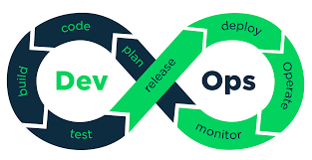

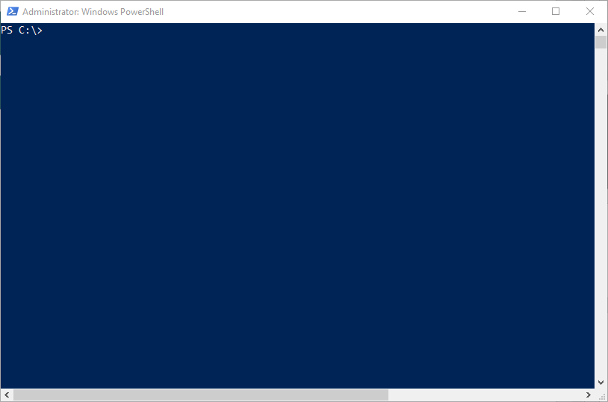


The IT world has changed…

Slide 6
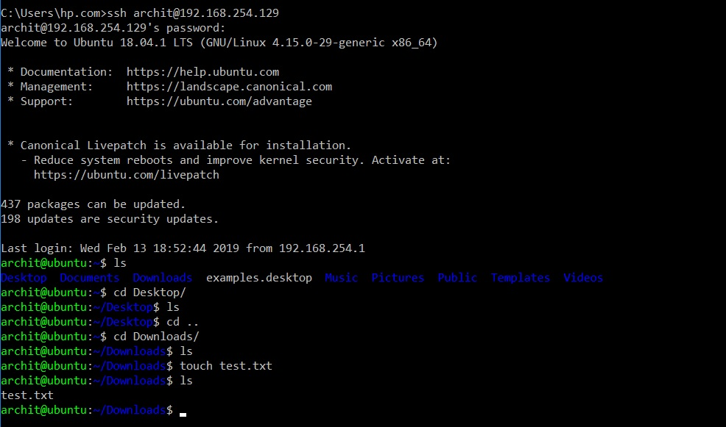

Slide 7
What is PowerShell Remoting?
Connecting to a remote computer via Windows Remoting
CIM cmdlets & Invoke-Command = PSRemoting
PS Remoting runs via the Windows Remote Management service (WinRM)
WinRM uses the WSMan protocol to make the connection to another machine (http: 5985 & https:5986)
All connections are encrypted by default

Slide 8



How does Remoting work?
http 5985 / https 5986
Encrypted connection (256 bit key)
Local PowerShell session authenticates against remote client. - Enter-PSSession
- Invoke-Command
- Any CIM cmdlets
01
Commands typed on the local system are sent to a remote computer and executed locally ON THE REMOTE SYSTEM.
03
The remote system EXECUTES the commands locally and sends the results back to the local system.
04
Identity confirmed. Privileges granted based on local group membership on remote PC
PS session created on remote system via WS-MAN / WinRM
02

Slide 9
PS cmdlets that support remoting
PS C:\> get-command -Noun *cim*
CommandType Name
---------- -------
Cmdlet Get-CimAssociatedInstance
Cmdlet Get-CimClass
Cmdlet Get-CimInstance
Cmdlet Get-CimSession
Cmdlet Invoke-CimMethod
Cmdlet New-CimInstance
Cmdlet New-CimSession
Cmdlet New-CimSessionOption
Cmdlet Register-CimIndicationEvent
Cmdlet Remove-CimInstance
Cmdlet Remove-CimSession
Cmdlet Set-CimInstance
Cmdlet Invoke-Command
PS C:\> get-command -Noun *pssess*
CommandType Name
----------- ------
Cmdlet Connect-PSSession
Cmdlet Disable-PSSessionConfiguration
Cmdlet Disconnect-PSSession
Cmdlet Enable-PSSessionConfiguration
Cmdlet Enter-PSSession
Cmdlet Exit-PSSession
Cmdlet Export-PSSession
Cmdlet Get-PSSession
Cmdlet Get-PSSessionCapability
Cmdlet Get-PSSessionConfiguration
Cmdlet Import-PSSession
Cmdlet New-PSSession
Cmdlet New-PSSessionConfigurationFile
Cmdlet New-PSSessionOption
Cmdlet Receive-PSSession
Cmdlet Register-PSSessionConfiguration
Cmdlet Remove-PSSession
Cmdlet Set-PSSessionConfiguration
Cmdlet Test-PSSessionConfigurationFile
Cmdlet Unregister-PSSessionConfiguration

Slide 10
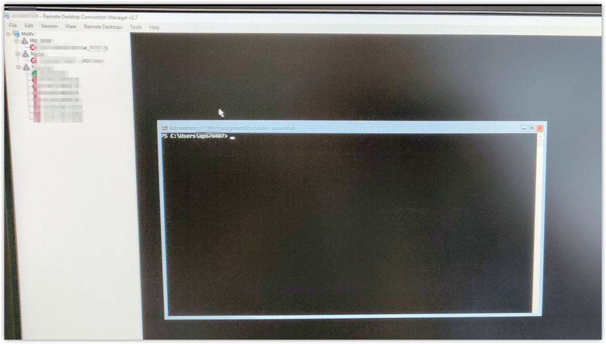
Not everyone has REMOTING figured out yet…

Slide 11



PSREMOTING is the connection & HANDSHAKE between nodes

Slide 12
PowerShell Authentication
PS Remoting was designed to work with Active Directory
Authentication occurs using Kerberos for AD Domain-joined computers
Authentication occurs using NTLM or SSL for workgroup computers
01
02
01
02
Local PowerShell session authenticates against remote client. - Enter-PSSession
- Invoke-Command
- Any CIM cmdlets
Identity confirmed. Privileges granted based on local group membership on remote PC
PS session created on remote system via WS-MAN / WinRM

Slide 13
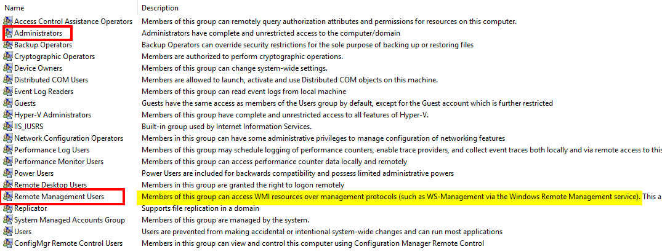
Local Group Membership

